Slide 1

CSAI 801 Project: COVID-19 Outcome Prediction
Dr. Marwa Elsayed
Eng. Amr Zaki

Slide 2
NAME: Bilal Mohamed Fetouh Mohamed Morsy
ID : 20398551

Slide 3
Project Description
The data used in this project will help to identify whether a person is going to recover from coronavirus symptoms or not based on some pre-defined standard symptoms.
These symptoms are based on guidelines given by the World Health Organization (WHO). This dataset has daily level information on the number of affected cases, deaths and recovery from 2019 novel coronavirus.
The data is available from 22 Jan,2020.

Slide 4
data of the project
Our data in this project is used for classifying the death and recovery of Covid-19 patients. It consists of (14) features which are:
1. Country: where the person resides
2. Location: which part in the Country
3. Age: Classification of the age group for each person, based on WHO Age Group Standard
4. Gender: Male or Female
5. Visited_Wuhan: whether the person has visited Wuhan, China or not
6. From_Wuhan: whether the person is from Wuhan, China or not
7. Symptoms: there are six families of symptoms that are coded in six fields (symptoms 1 till 6)
8. Time_before_symptoms_appear: period of time before being suspected as a Covid-19 patient
9. Result: death (1) or recovered (0)

Slide 5
Data Preprocessing
As mentioned in the description that, The data is already cleaned and preprocessed.
The shape of the data is Row 863 Column 14.
There are 13 features and 1 label column (target data).
In the training data, there is a column called ( Unnamed: 0) will be dropped.
Split the data into Train and Test by 80% for training to 20% for testing.
Normalize the data values using StandardScaler which most algorithms need that.

Slide 6
Models to analysis the project
You need to design the following classifiers:
1. K-Nearest Neighbors (Without SMOTE and With SMOTE)
2. Logistic Regression (Without SMOTE and With SMOTE)
3. Naïve Bayes (Without SMOTE and With SMOTE)
4. Decision Trees (Without SMOTE and With SMOTE)
5. Support Vector Machines (Without SMOTE and With SMOTE)
For each classifier, find the optimal hyperparameters.

Slide 7
The Optimal Hyperparameters For each classifier
We used GridSearchCV to find the optimal hyperparameters.
What is grid search?
The idea that hyperparameter tuning using (scikit-learn’s GridSearchCV) was the greatest invention of all time.
It runs through all the different parameters that is fed into the parameter grid and produces the best combination of parameters, based on a scoring metric of your choice (Accuracy, F1, etc.).
The parameters in GridSearchCv are :
estimator: estimator object being used.
param_grid: dictionary that contains all of the parameters to try.
scoring: evaluation metric to use when ranking results.
cv: cross-validation, the number of cv folds for each combination of parameters.

Slide 8
performance of all classifiers using different metrics
Confusion Matrix: a table showing correct predictions and types of incorrect predictions.
Precision: the number of true positives divided by all positive predictions. Precision is also called Positive Predictive Value. It is a measure of a classifier’s exactness. Low precision indicates a high number of false positives.
Recall: the number of true positives divided by the number of positive values in the test data. The recall is also called Sensitivity or the True Positive Rate. It is a measure of a classifier’s completeness. Low recall indicates a high number of false negatives.
F1: Score: the weighted average of precision and recall.
Area Under ROC Curve (AUROC): AUROC represents the likelihood of your model distinguishing observations from two classes.

Slide 9
1. K-Nearest Neighbors (Without SMOTE)
 | KNN | KNN with Best parameters
Data Splitting | Training = 80 % Testing = 20 % | Cv= 10
Hyperparameters | 'n_neighbors': [1, 2, 3, 4, 5, 6, 7, 8, 9, 10, 11, 12, 13, 14]} | N_Neighbors = 6
 | Metric = 'minkowski' | Metric = 'minkowski'
 | P = 2 | P = 2
 | Weights = ['uniform', 'distance'] | Weights = 'distance'
 | estimator=KNeighborsClassifier() | estimator=KNeighborsClassifier()
 | scoring='accuracy' | scoring='accuracy'

Slide 10
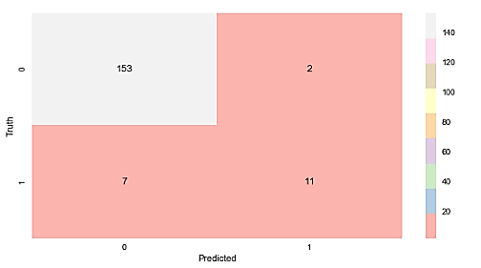
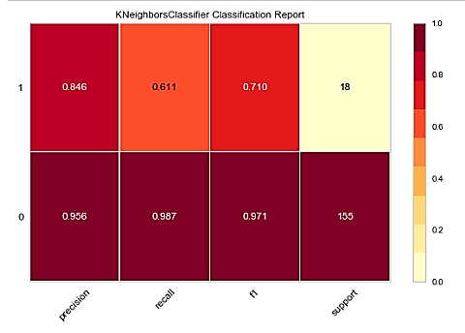
Confusion Matrix and classification report(KNN)

Slide 11
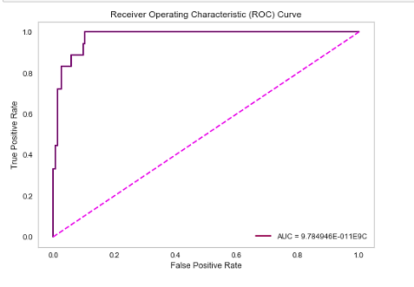
The ROC Curve(KNN)
The AUC = 97.8 %

Slide 12
2. Logistic Regression (Without SMOTE)
 | Logistic Regression | Logistic Regression with Best parameters
Data Splitting | Training = 80 % Testing = 20 % | Cv= 10 , max_iter = 300
Hyperparameters | 'C':[0.001, 0.005, 0.08, 0.1, 0.5, 0.8, 1.2, 1, 5, 10, 25,100000.0] | 'C’: 5
 | 'solver': ['newton-cg', 'lbfgs', 'liblinear', 'sag', 'saga'] | 'solver': 'liblinear'
 | estimator=LogisticRegression() | estimator=LogisticRegression ()
 | scoring='accuracy' | scoring='accuracy'

Slide 13
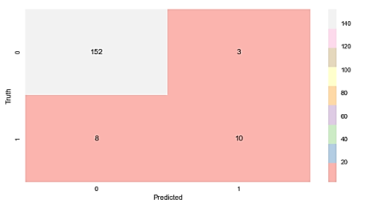
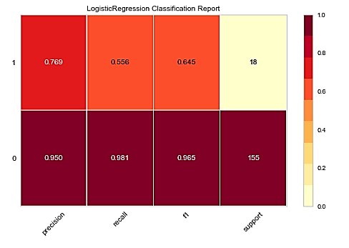
Confusion Matrix and classification report(Logreg)

Slide 14
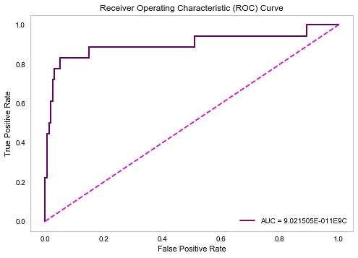
The ROC Curve(logreg)
The AUC = 90.2%

Slide 15
3. Bernoulli Naive Bayes (Without SMOTE)
 | Bernoulli Naive Bayes | Bernoulli Naive Bayes with Best parameters
Data Splitting | Training = 80 % Testing = 20 % | Cv= 10
Hyperparameters | 'alpha': [1, 2, 3, 4, 5, 6, 7, 8, 9, 10, 11, 12, 13,14, 15, 16, 17, 18, 19] | 'alpha': 5,
 | 'binarize': [1, 2, 3, 4, 5, 6, 7, 8, 9, 10, 11, 12, 13,14, 15, 16, 17, 18, 19] | 'binarize': 1,
 | estimator=BernoulliNB(alpha=1, binarize=1) | BernoulliNB(alpha = 5, binarize=1, fit_prior = True)
 | scoring='accuracy' | scoring='accuracy'
 | n_jobs=-1 | n_jobs=-1
 | 'fit_prior': [True, False] | 'fit_prior': True

Slide 16
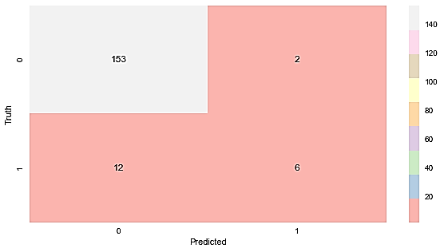
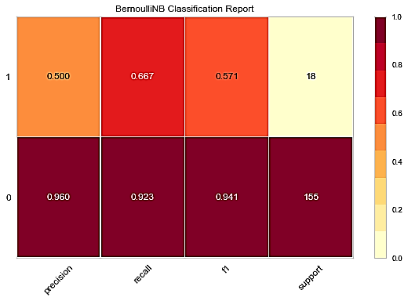
Confusion Matrix and classification report(Naive Bayes )

Slide 17
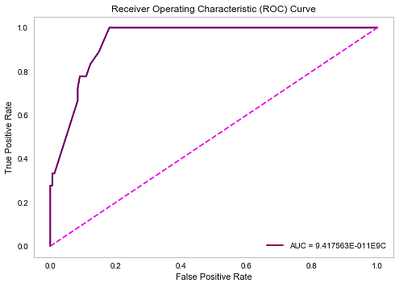
The ROC Curve(Naive Bayes )
The AUC = 94.2%

Slide 18
4. Support vector machine(SVM) (Without SMOTE)
 | Support vector machine | Support vector machine with Best parameters
Data Splitting | Training = 80 % Testing = 20 % | Cv= 10
Hyperparameters | 'C': [0.1, 1, 10, 100] | 'C': 10
 | 'gamma': [1, 0.1, 0.01, 0.001, 0.0001] | 'gamma': 0.1
 | estimator=SVC(random_state=3) | estimator=SVC(C=10, gamma=0.1, probability=True, random_state=0)
 | 'kernel': ['linear', 'rbf'] | 'kernel': 'rbf'
 | 'probability': [True, False] | probability': True
 | scoring='accuracy' | scoring='accuracy'
 | n_jobs=-1 | n_jobs=-1

Slide 19

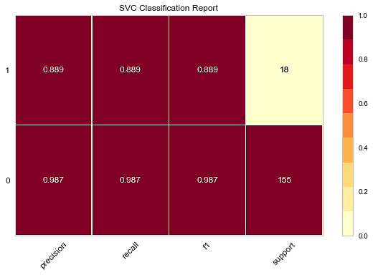
Confusion Matrix and classification report(SVM)

Slide 20
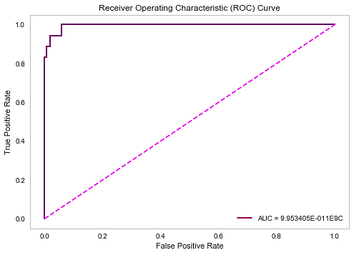
The ROC Curve(SVm)
The AUC = 99.5%

Slide 21
5. Decision Tree (Without SMOTE)
 | Decision Tree | Decision Tree with Best parameters
Data Splitting | Training = 80 % Testing = 20 % | Cv= 10
Hyperparameters | 'criterion': ['gini', 'entropy'] | criterion= "gini"
 | 'max_depth': [1, 2, 3, 4, 5, 6, 7, 8, 9, 10, 11, 12, 13, 14, 15, 16, 17, 18, 19] | max_depth= 7
 | estimator=DecisionTreeClassifier(random_state=3) | estimator=DecisionTreeClassifier(criterion= "gini", max_depth= 7 , min_samples_leaf= 1 , random_state= 3)
 | scoring='accuracy' | scoring='accuracy'
 | 'min_samples_leaf': [1, 2, 3, 4, 5, 6, 7, 8, 9, 10, 11, 12, 13, 14, 15, 16, 17, 18, 19] | min_samples_leaf= 1

Slide 22
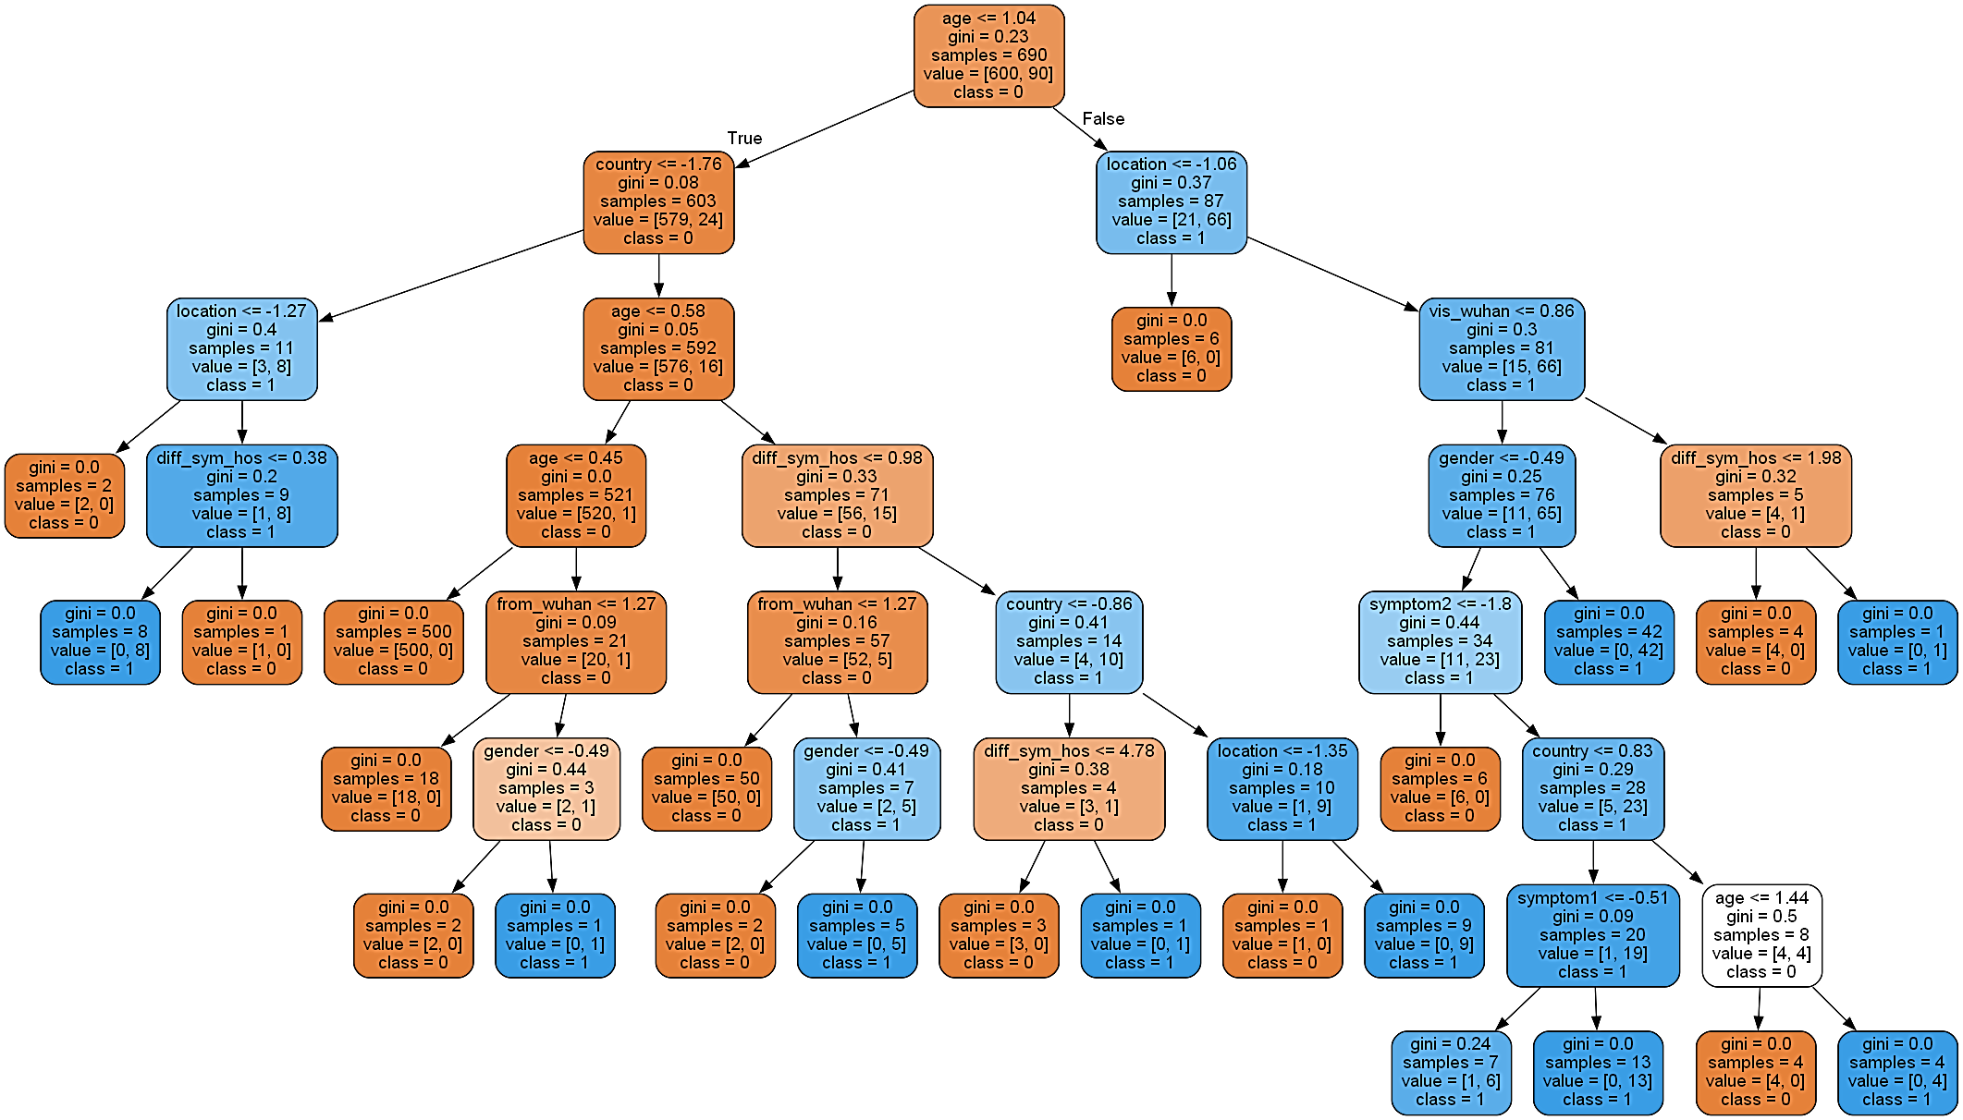
The Visualization for the Tree

Slide 23

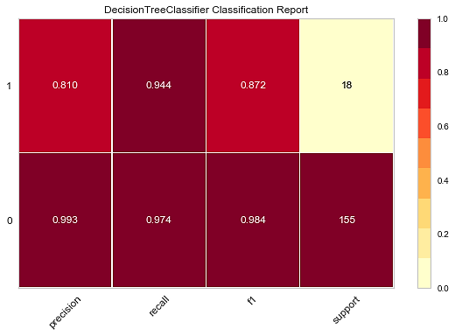
Confusion Matrix and classification report(DT)

Slide 24
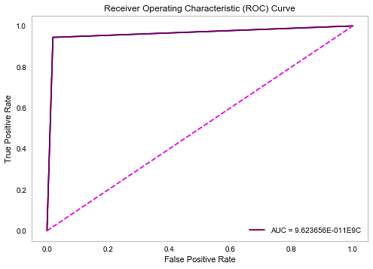
The ROC Curve(Dt)
The AUC = 96.24%

Slide 25
Comparison between the five classifiers

Slide 26
The Best Model
The good news is that all models are above 90% accuracy.
From visualization, we found that the SVM model has the highest one. Then Decision Tree with respect to
Precision
Recall
F1: Score
Area Under ROC Curve (AUROC)
SVM
Rank 1
DT
kNN
Rank 3
Rank 2

Slide 27
Class Imbalance in Machine Learning
Most machine learning algorithms work best when the number of samples in each class are about equal. This is because most algorithms are designed to maximize accuracy and reduce errors.
However, if the data set in imbalance then In such cases, you get a pretty high accuracy just by predicting the majority class, but you fail to capture the minority class, which is most often the point of creating the model in the first place.
Change the performance metric
Accuracy is not the best metric to use when evaluating imbalanced datasets as it can be misleading.
Metrics that can provide better insight are:
Confusion Matrix
Precision
Recall
F1: Score
Area Under ROC Curve (AUROC)

Slide 28
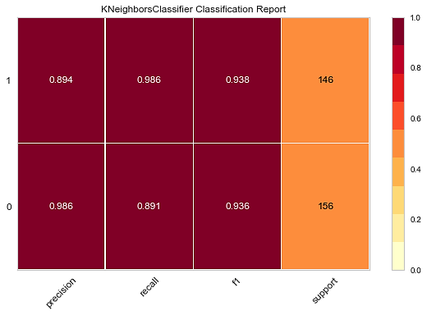
1. K-Nearest Neighbors (With SMOTE)
After Applying The SMOTE
Before Applying The SMOTE

Slide 29
1. K-Nearest Neighbors (With SMOTE)
After Applying The SMOTE(The Best)
Before Applying The SMOTE

Slide 30
Performance | KNN(With SMOTE) | KNN(Without SMOTE)
Precision | 0 => 98.6 % / 1 => 89.4 % | 0 => 95.6 % / 1 => 84.6 %
Recall | 0 = > 89.1 % / 1 => 98.6 % | 0 = > 98.7 % / 1 => 61.1 %
F1-score | 0 => 93.6% / 1 => 93.8 % | 0 => 97.1 % / 1 => 71 %
ROC/AUC | 98.2% | 97.8%

Slide 31
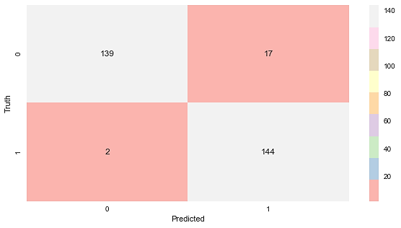
1. K-Nearest Neighbors (With SMOTE)
After Applying The SMOTE
Before Applying The SMOTE

Slide 32
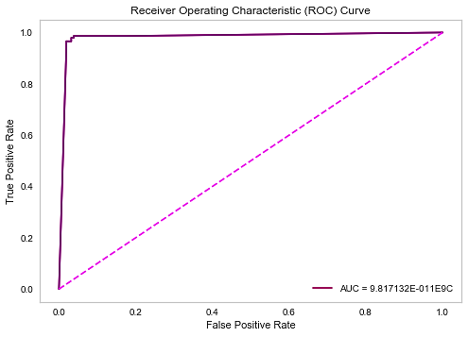
1. K-Nearest Neighbors (With SMOTE)
The AUC = 98.2 %
The AUC = 97.8 %
After Applying The SMOTE(The Best)
Before Applying The SMOTE

Slide 33
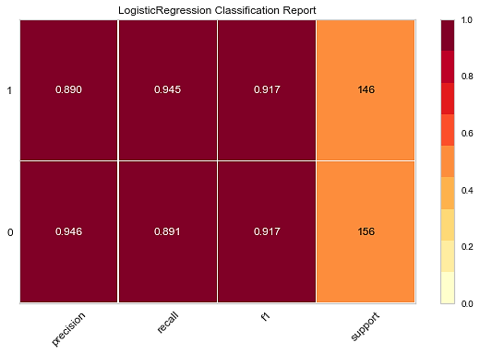
2. Logistic Regression (With SMOTE)
After Applying The SMOTE(The Best)
Before Applying The SMOTE

Slide 34
2. Logistic Regression (With SMOTE)
After Applying The SMOTE(The Best)
Before Applying The SMOTE

Slide 35
Performance | LogReg(With SMOTE) | LogReg(Without SMOTE)
Precision | 0 => 94.6 % / 1 => 89 % | 0 => 95 % / 1 => 76.9 %
Recall | 0 = > 89.1 % / 1 => 94.5 % | 0 = > 98.1% / 1 => 55.6 %
F1-score | 0 => 91.7% / 1 => 91.7% | 0 => 96.5 % / 1 => 64.5 %
ROC/AUC | 95.5% | 90.2%

Slide 36
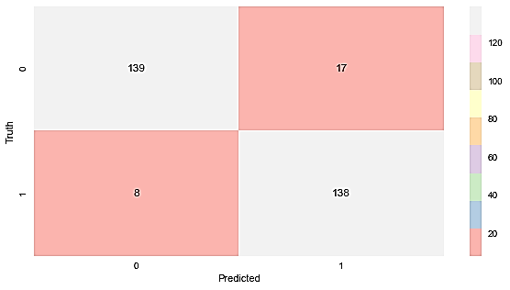
2. Logistic Regression (With SMOTE)
After Applying The SMOTE(The Best)
Before Applying The SMOTE

Slide 37
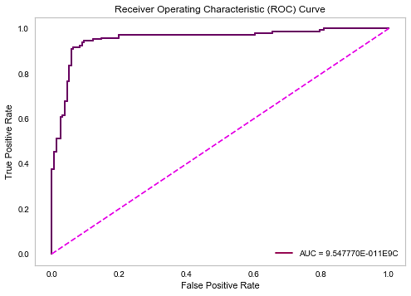
2. Logistic Regression (With SMOTE)
The AUC = 95.5%
The AUC = 90.2%
After Applying The SMOTE(The Best)
Before Applying The SMOTE

Slide 38
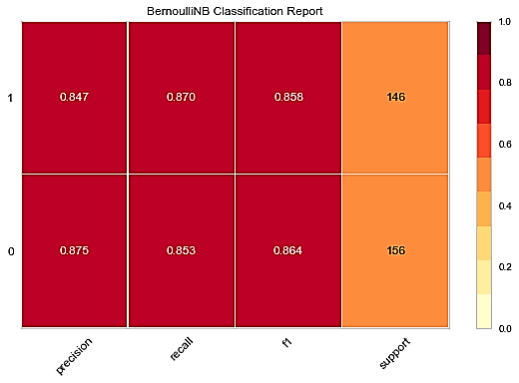
3. Bernoulli Naive Bayes (With SMOTE)
After Applying The SMOTE(The Best)
Before Applying The SMOTE

Slide 39
3. Bernoulli Naive Bayes (With SMOTE)
After Applying The SMOTE(The Best)
Before Applying The SMOTE

Slide 40
Performance | Naive Bayes(With SMOTE) | Naive Bayes(Without SMOTE)
Precision | 0 => 87.5 % / 1 => 84.7 % | 0 => 96 % / 1 => 50 %
Recall | 0 = > 85.3 % / 1 => 87 % | 0 = > 92.3% / 1 => 66.7 %
F1-score | 0 => 86.4% / 1 => 85.8% | 0 => 94.1 % / 1 => 57.1 %
ROC/AUC | 92.1% | 94.2%

Slide 41
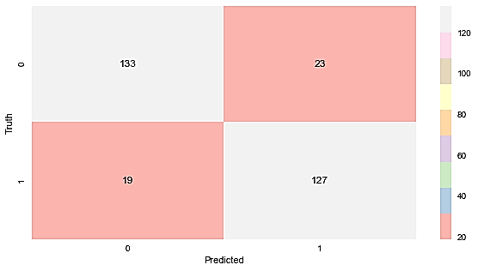
3. Bernoulli Naive Bayes (With SMOTE)
After Applying The SMOTE(The Best)
Before Applying The SMOTE

Slide 42
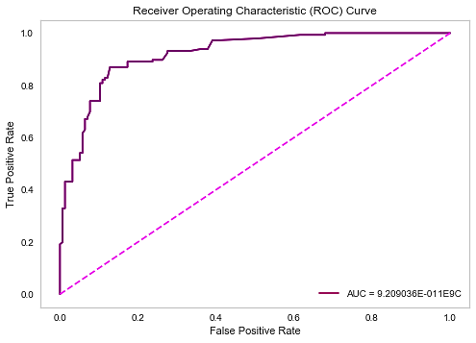
3. Bernoulli Naive Bayes (With SMOTE)
The AUC = 92.1%
The AUC = 94.2%
After Applying The SMOTE
Before Applying The SMOTE (The Best)

Slide 43
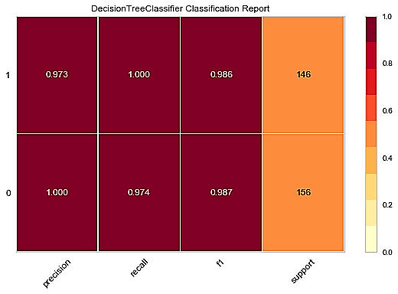
4. Decision Tree (With SMOTE)
After Applying The SMOTE(The Best)
Before Applying The SMOTE

Slide 44
4. Decision Tree (With SMOTE)
After Applying The SMOTE(The Best)
Before Applying The SMOTE

Slide 45
Performance | DT(With SMOTE) | DT(Without SMOTE)
Precision | 0 => 100 % / 1 => 97.3% | 0 => 99.3 % / 1 => 81 %
Recall | 0 = > 97.4 % / 1 => 100 % | 0 = > 97.4% / 1 => 94.4 %
F1-score | 0 => 98.7% / 1 => 98.6% | 0 => 98.4 % / 1 => 87.2%
ROC/AUC | 98.98% | 96.24%

Slide 46

4. Decision Tree (With SMOTE)
After Applying The SMOTE(The Best)
Before Applying The SMOTE

Slide 47

4. Decision Tree (With SMOTE)
The AUC = 98.98%
The AUC = 96.24%
After Applying The SMOTE (The Best)
Before Applying The SMOTE

Slide 48
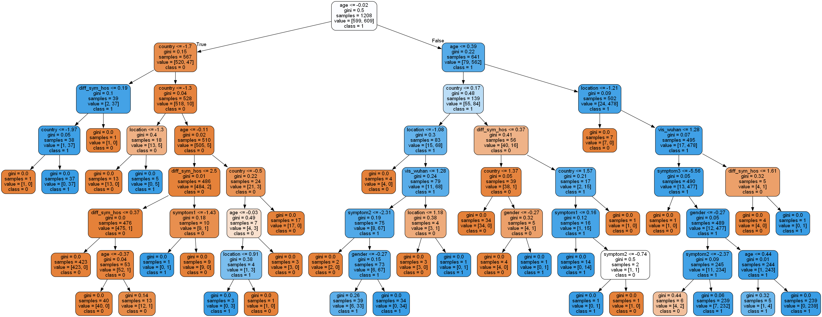
The Visualization for the Tree(With SMOte)

Slide 49
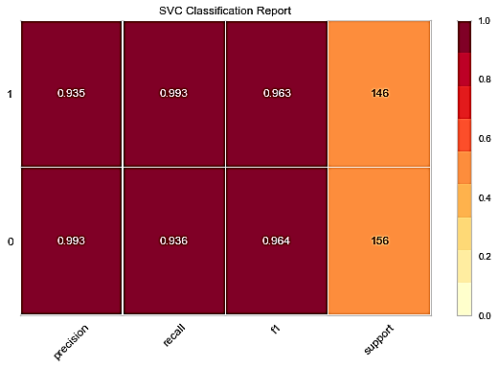
5. Support vector machine(SVM) (With SMOTE)
After Applying The SMOTE(The Best)
Before Applying The SMOTE

Slide 50
5. Support vector machine(SVM) (With SMOTE)
After Applying The SMOTE(The Best)
Before Applying The SMOTE

Slide 51
Performance | SVM(With SMOTE) | SVM(Without SMOTE)
Precision | 0 => 99.3 % / 1 => 93.5% | 0 => 98.7 % / 1 => 88.9 %
Recall | 0 = > 99.3 % / 1 => 93.6 % | 0 = > 98.7% / 1 => 88.9 %
F1-score | 0 => 96.4% / 1 => 96.3% | 0 => 98.7 % / 1 => 88.9%
ROC/AUC | 99.47% | 99.5%

Slide 52

5. Support vector machine(SVM) (With SMOTE)
After Applying The SMOTE(The Best)
Before Applying The SMOTE

Slide 53

5. Support vector machine(SVM) (With SMOTE)
The AUC = 99.47%
The AUC = 99.5%
After Applying The SMOTE
Before Applying The SMOTE

Slide 54
Comparison between the five classifiers(with smote)

Slide 55
The Best Model(with smote)
The good news is that all models are above 92% accuracy.
From visualization, we found that the SVM model has the highest one. Then Decision Tree with respect to
Precision
Recall
F1: Score
Area Under ROC Curve (AUROC)
SVM
Rank 1
DT
kNN
Rank 3
Rank 2
Compared the performance of the models before and after applying SMOTE, The models have a big enhancement and high improvement specially in logistic regression.

Slide 56
Resources
Sklearn Documentation
Stackoverflow
scikit-learn package
Classification Report from yellowbrick.classifier

